Slide 1


Fast Segmentation of 3D Point Clouds: A Paradigm on LiDAR Data for Autonomous Vehicle Applications
Dimitris Zermas, Izzat Izzat, Nikos Papanikolopoulos
Notes:
Hi, my name is Dimitris Zermas and I am a PhD Candidate at the University of Minnesota.
This is a work that I developed with the collaboration of my supervisor in DELPHI, Izzat Izzat and the guidance of my advisor at the UoM Nikos Papanikolopoulos.
This is an algorithm for fast segmentation of 3D point clouds.
The point clouds have been acquired by a LiDAR sensor and we are focusing on an application regarding autonomous vehicles.

Slide 2
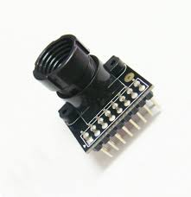
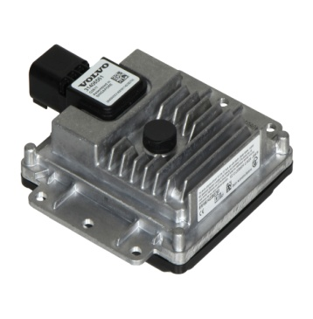
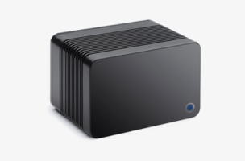
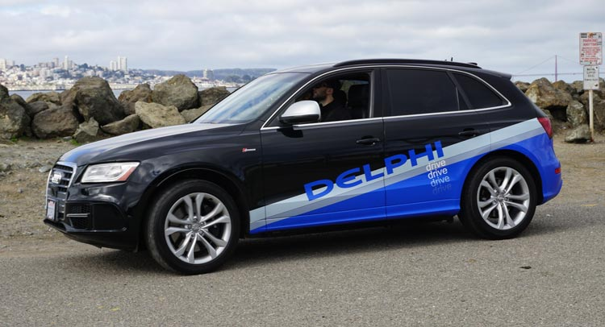
LiDAR for Autonomous Driving
Enhanced Safety
Camera
Radar
LiDAR
Accurate depth measurements
Long range
Solid State LiDARs will lower the cost
Notes:
Information on the environment surrounding an autonomous vehicle is crucial for the safety of the vehicle passengers and the people interacting with it.
In multiple occasions, cameras and radars are not enough for the acquisition of this information.
(click) LiDAR sensors are able to complement existing safety systems and enhance the autonomous driving system’s capabilities.
(click) They offer accurate depth measurements, long sensing range, and the development of solid state LiDARs will lower their cost making them appealing to the automotive industry.
The demand for fast algorithms tailored around autonomous driving applications is apparent.

Slide 3
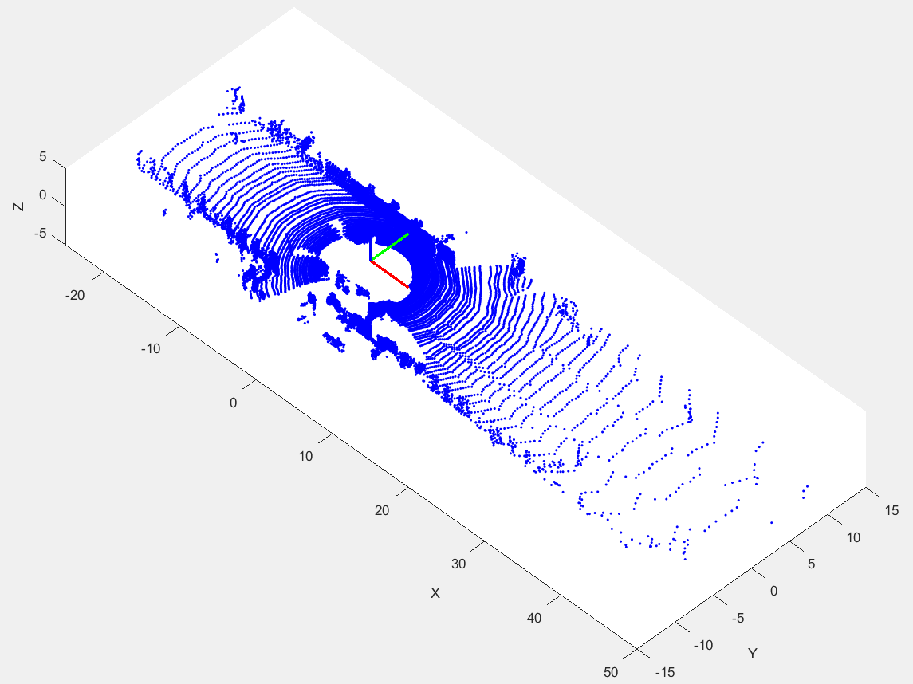
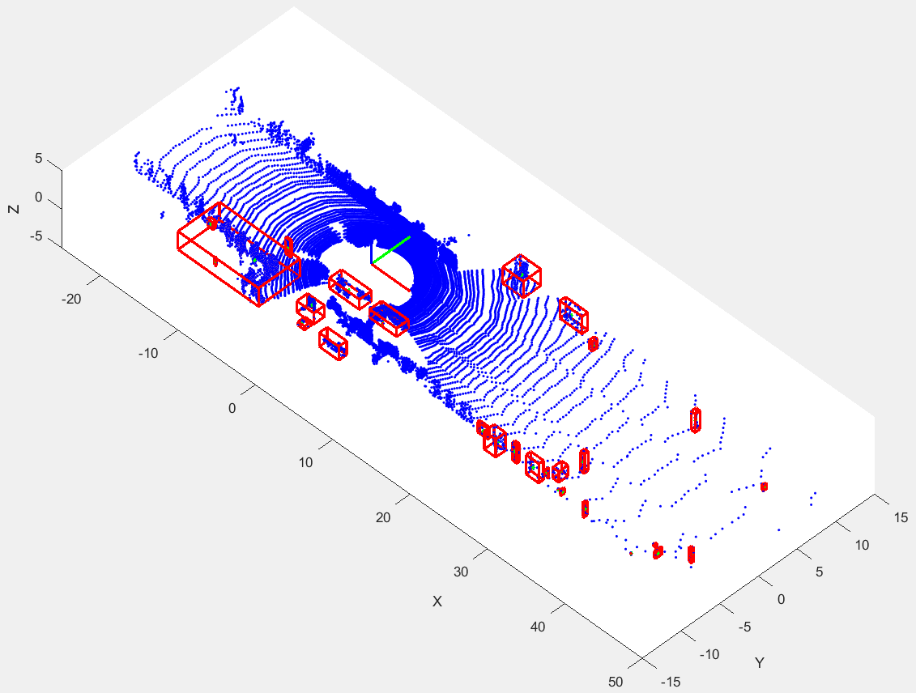
Pipeline
Testing on KITTI Dataset
Input:
LiDAR Point Clouds
Output:
Meaningful Clusters
Remove ground points
Cluster the rest FAST
Notes:
We tested our algorithm extensively on the KITTI Dataset.
The input is a Point Cloud frame representing the environment of the vehicle at particular time instance.
(click) The output is meaningful clusters of points representing objects of interest in the surroundings.
Initially, we are removing the points representing the ground and then we cluster the remaining points fast.

Slide 4
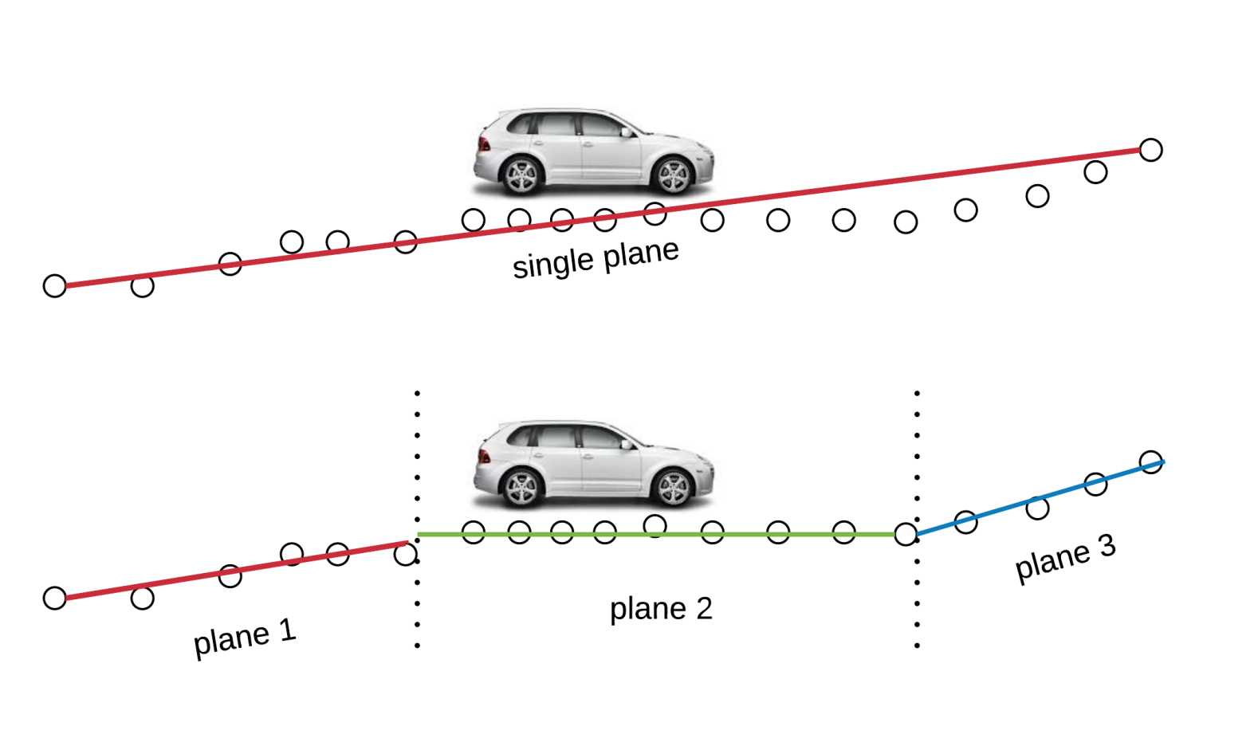
Ground Removal - Ground Plane Fitting (GPF)
Fit planes to the ground
Multiple planes for
rough terrain
Start from “plane 2”
Move forward
Move backward
Secure plane continuity
Notes:
The idea for ground point removal is simple; we are fitting planes along the direction of the car’s trajectory.
Instead of fitting only one plane, we are fitting several.
This way it is possible to accommodate for ground planes with changing slope.
The fitting starts from the plane surrounding the vehicle (plane 2), because it is more reliable to seed the algorithm with points that are close to the sensor.
(click) Starting from the vehicle’s surrounding plane, the algorithm is scanning the point cloud first forwards and
(click) then backwards trying to fit planes,
(click) while maintaining continuity between them.

Slide 5


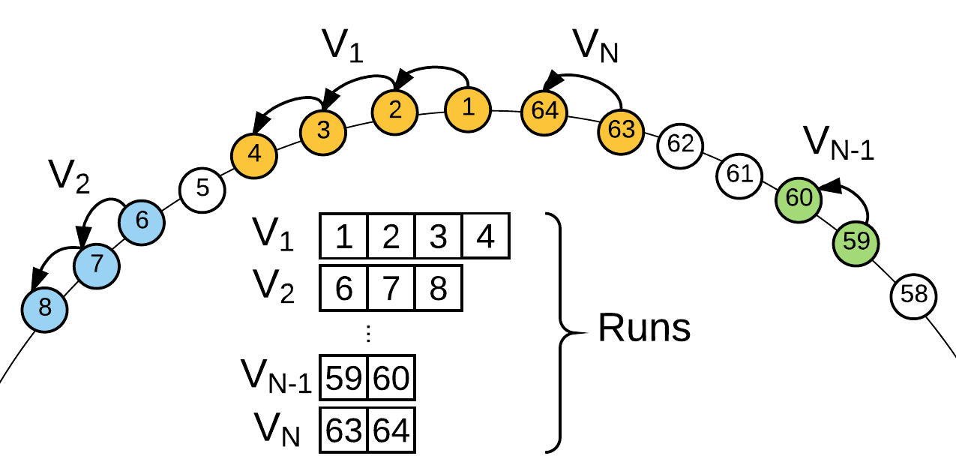
Fast Clustering – Scan Line Run (SLR)
LiDAR sweeping
Image Raster Scan
Treat the Point Cloud as a 2D image
Scan Lines = measurements
from same ring
Runs = continuous measurements
on the same Scan Line
Reduced search space = Fast clustering
Scan Lines
Notes:
The algorithm for fast clustering, the “Scan Line Run” (SLR) is the second contribution of our work.
The LiDAR is sweeping its surroundings in a way that reminds us of a raster scan.
This inspired us to treat the scan lines of the LiDAR point cloud as rows of a 2D image and perform connected component labeling techniques directly influenced by algorithms for binary images.
(click) We say that the LiDAR measurements that come from the same ring form a “Scan Line”.
(click) Each “Scan Line” consists of measurements that belong to the ground or an object of interest.
In this example the white circles are treated as background and the colored circles are treated as foreground.
Continuous colored circles form a “Run”.
Combining “Runs” of a “Scan Line” with the “Runs” of neighboring “Scan Lines” allows for very fast clustering because the search space is immensely reduced.

Slide 6
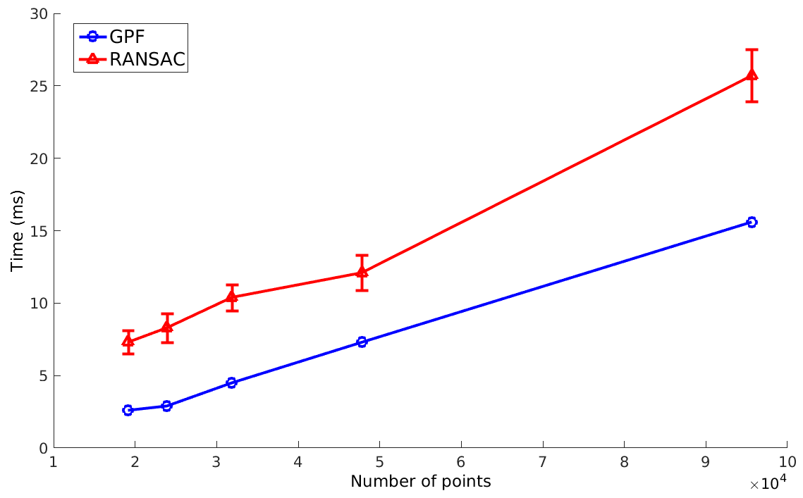
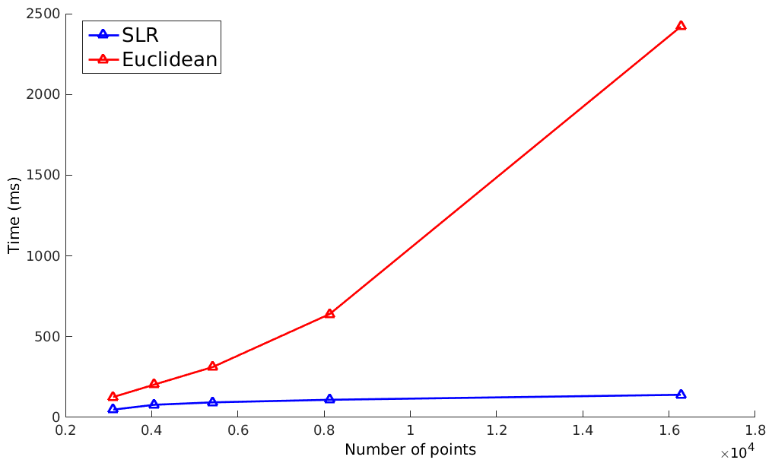
Results
Ground Detection
Clustering
Fast running time
Scalability
Extension to RGB+D sensors
Notes:
Our algorithm achieves faster running time when compared to of-the-self algorithms that perform similar tasks.
We take advantage of the structured data the LiDAR sensor provides and show that clustering can be scalable and independent of the number of points in the point cloud.
This approach can be applied with minor modifications to data gathered by RGB+D sensors.
For more details and results on this project, please join me at the … kiosk right after the end of this session. Thank you for you attention.

